Slide 1
Greenbrae’s Back to School Night & Title 1 Presentation
2024-2025

Slide 2
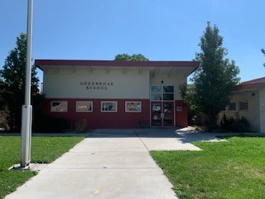
WELCOME TO GREENBRAE ELEMENTARY SCHOOL
Every student counts, Every moment matters
9/10/2024
5:30 – 6:30pm
Welcome
1st Rotation
2nd Rotation
Goodbye

Slide 3
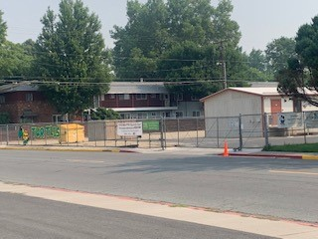
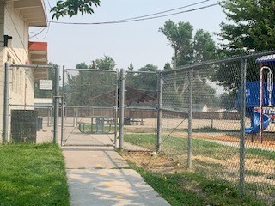
Arrival All students can arrive at 8:40. Main gate on 4th street and Kinder gate on O street will open at 8:40, we ask that everyone enters through the gate on 4th street except kinder or siblings that are dropping them off. First bell rings at 8:55 and late bell at 9:00am Students are marked tardy at 9:00am
Dismissal - Students will exit through….
Kinder & First grade – O street
Second- Fifth Grade on the grass area on 4th st
Dismissal times:
Monday – Friday
3:00pm
Wednesdays
2:15 pm

Slide 4
Breakfast/Recess/Lunch
Breakfast is delivered to the classroom.
Students will be eating lunch in the MPR.
Students have 1-3 options every day for lunch
You can find the breakfast and lunch menu at
https://www.washoeschools.net/Page/8153
Our amazing lunch staff
Ms. Michelle & Mrs. Hurtado

Slide 5
Clinic Procedures
Clinic Staff – Nurse Jasmine Magana & Clinical Aid Eloisa Cervantes
The WCSD consistently meets with the WCHD to receive updated guidance regarding the safest way to respond to illness in the school district.
Fever – The ill student needs to be fever free for 24 hours without medication prior to return
Vomiting/diarrhea – The ill student should not experience any vomiting/diarrhea for 24 hours without medication prior to returning
Yellow or greenish drainage from eyes, nose, or ears – The ill student can return to school if they have taken antibiotic for the 24 hours before returning or drainage has completely resolved
Sore Throat – The ill student will be sent home and should be seen by healthcare provider if symptoms worsen. The student may return the fallowing day if symptoms improve.
Cough – The student may attend school unless they have a fever or other symptoms indicating a possible infection
Please consult with the school nurse if you any questions.

Slide 6
2024-2025 Attendance office Staff Sarah Lucey – Secretary Adora Spence – Attendance Clerk
Greenbrae strives to make everyday count and recognize that regular attendance is a critical key to success in a child’s school career. The staff at Greenbrae works with students and families to support good attendance habits.
Students are expected to attend all day, every day.
Students must arrive by 8:55 (Gates open at 8:40)
Please remember to self screen and call the school if your child is sick. PLEASE keep the child home if he or she is sick.
For any absences, ALL reasons must be called in.

Slide 7
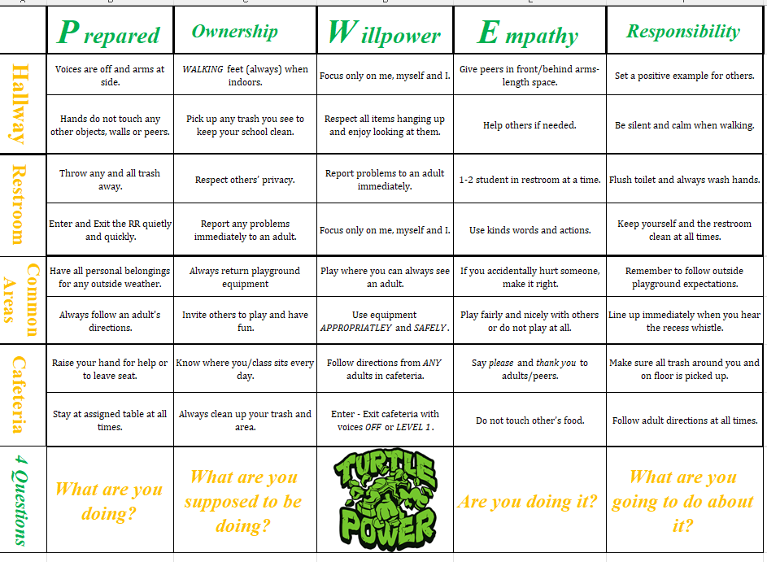
PBIS Positive Behavior Intervention and Support
Progress Discipline Plan - (4 Questions)
What are you doing?
What are you supposed to be doing?
Are you doing it?
What are you going to do about it?
Natural Consequences
Student Self Reflection
Think Sheet
Logical Consequences
i.E loss of recess
Appropriate behavior is always expected / fallowing our POWER matrix
Social and Emotional Learning / Restorative Practices & Circles
Focus on rewarding positive behavior and peer interactions daily, using Turtle Tickets
POWER
-PREPARED
-OWNERSHIP
-WIllPOWER
-EMPATHY
-RESPONSIBILITY

Slide 8
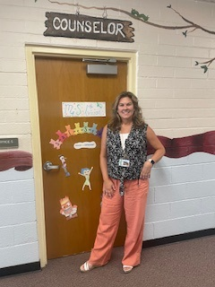
Meet our Fabulous Counselor Mrs. Solvason
What does a School Counselor do?
Works alongside parents, teachers and administrators to help students develop socially and emotionally. My focus is to help students resolve academic, social, personal or emotional concerns that interrupt the education.
Students supports provided
Short term individual counseling
Small group counseling
Classroom guidance lessons
Crisis intervention
Parent referrals and support

Slide 9
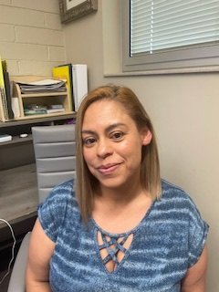
FACE LIAISON (Family and Community Engagement) Mrs. Hinojosa
What resources does the FACE offer? ¿Qué recursos ofrece la FACE?
Support, and train staff members at our school site to offer family/parent workshops to promote home-school partnerships and to honor the parents' role as a child's first and most important teacher.
Apoya y capacita a los miembros del personal en nuestra escuela para ofrecer talleres para padres y familias para promover las asociaciones entre el hogar y la escuela y honrar el papel de los padres como el primer y más importante maestro de un niño.
One-on-one check-ins with families
Juntas individuales con las familias
Resource referrals
Referencias de recursos
Interpreter (English & Spanish)
Interprete (Inglés y español)

Slide 10
Overview of Title I
Title I is a federal-funded grant program that provides:
schools with additional academic support and learning to help students meet the state’s challenging academic standards.
opportunities for students at schools that have higher percentages of socioeconomically disadvantaged children
workshops and training opportunities for parents and families to increase their engagement in their children’s education.
Notes:
The purpose of Title I is to ensure ALL children have a fair, equitable and significant opportunity for a high-quality education and read, at a minimum, proficiency on state standards and assessments

Slide 11
Requirements of a Title I School
Annual Title I Parent Meeting
High Quality Curriculum
Academic Assistance to Students
Family Engagement and Input
Annual Survey of Title I Program
Timely Communication to Parents
Notes:
Title I schools must hold an Annual Title I meeting letting families know of their school’s participation in and explain the requirements of Title I, that there is a parent and family engagement policy, and that families have a right to be involved in the school. Teachers must meet state certification and licensure requirements. Parents can ask for information on policies regarding student participation in assessments. Teachers will provide information about the high-quality curriculum and the types of academic assistance provided at the school.

Slide 12
Participation
Schoolwide Basis - Funds used to serve all students in order to increase academic achievement.
Notes:
To be a “schoolwide” school the school must have a free/reduced lunch count of at least 40%, collect and analyze data that affects student achievement, and must develop a comprehensive site plan (School Performance Plan) and annually review its effectiveness.

Slide 13
Program Funds
Amount of Title I funds available for this year
$134,000.00
Title I budget consists of:
FACE Liaison
Library Books
Student School Supplies
Technology – Student Laptops, Printer, Copy Machines, Laminator
InfoTech- Headphones, toner, etc.
Notes:
Tailor this to your school. Can also show parents how to get to School Performance Plan Budget page.

Slide 14
Parent and Family Engagement Policy
Notes:
Parents and families are invited to participate in the development and revision of the parent and family engagement policy. The policy will be available on the website before October 1 and will be revised in May for the following year.

Slide 15
Parents’ Right-to-Know – School Level
Individual report card on your child’s progress
Information on State and local assessments
Right of parents to become involved in the school’s programs and how to do so
Subject matter assessed
Purpose of the assessment
Volunteering
Flexible meetings
Monthly meetings
Other
Notes:
Parents can request information on any of these items and the school has to provide it in a timely manner. Report cards quarterly. Information on State and Local Assessments – parents can request more information on state and local assessments, i.e., practice tests, MAP, Brigance, ACT, etc.

Slide 16
“Parents’ Right to Know”
The Washoe County School District is committed to following all guidelines as established under the Every Student Succeeds Act, which is in effect during the 2024-25 school year.
You have the right to:
Know the level of achievement their child attained on each of the state academic assessments
Request information on the professional qualifications of your student’s classroom teachers, which should include meeting applicable NV state certification and licensure requirements for the grade levels and subject areas in which the teacher provides instruction. This would include teaching under emergency or other provisional status and is teaching in the field of discipline of the certification.
Request Information on the paraprofessionals (teacher aides, teacher assistants, etc.) providing services to your child. Paraprofessionals should meet one of the minimum requirements, which is a minimum of 48 college credit hours, an associate degree (or higher), or score at least 460 on the Parapro Assessment.
Be provided timely notice that your child has been assigned or taught for 4 or more consecutive weeks by a teacher with limited State certification or licensure.
Be provided information on each assessment required by the state and the school district. The information must include: 1. Subject matter assessed 2. Purpose of the assessment 3. Source of the requirement, and if information that includes a) Length of time expected and schedule for the assessments b) Time and format for disseminating results.
Request information regarding any State or local educational agency policy regarding student participation in any mandated assessments. The information must include a policy, procedure, or parental right to opt the child out of such assessment, where applicable.
The information regarding teacher’s qualifications in accordance with the Every Student Succeeds Act may be obtained through the school district. Please feel free to contact the WCSD Title I office or The Human Resources Department if you have any questions.
Cer tificate No. 4143
Notes:
Families will be receiving a letter similar to this in English and Spanish. Please contact the school or district if you would like more information.

Slide 17
“DERECHOS DE CONOCIMIENTO DE PADRES”
El Distrito Escolar del Condado de Washoe está comprometido a seguir las pautas establecidas De la Ley Cada Estudiante Triunfa, la cual está vigente durante el año escolar 2024-2025.
Usted tiene derecho a:
Conocer el nivel de logro de su hijo en cada una de las evaluaciones del estado académico.
Solicitar información sobre las calificaciones profesionales de los maestros de su hijo en el salón de clases, las cuales deben incluir cumplir con los requisitos de certificación y licenciatura estatales de NV para los niveles de grado y áreas temáticas en las que el maestro proporciona instrucción. Esto incluye la enseñanza en estado de emergencia u otro estado provisional y está enseñando en el campo de la certificación de disciplina.
Solicitar información sobre los para-profesionales (auxiliares de maestros, asistentes de maestros, etc.) que proveen servicios a su hijo. Los para-profesionales deben cumplir con uno de los requisitos mínimos, que es un mínimo de 48 horas de crédito universitario, un título de asociado (o superior), o puntuación de al menos 460 en la Evaluación Parapro.
Recibir aviso oportuno de que su hijo ha sido asignado o enseñado por 4 o más semanas consecutivas por un maestro con una certificación o licencia limitada del Estado.
Se le proporcionará información sobre cada evaluación requerida por el estado y el distrito escolar. La información debe incluir: 1. Asunto evaluado 2. Propósito de la evaluación 3. Origen del requisito y si la información incluye a) Tiempo esperado y calendario para las evaluaciones b) Tiempo y formato para difundir los resultados.
Solicitar información sobre cualquier agencia educativa estatal o local con respecto a la participación de los estudiantes en cualquier evaluación obligatoria. La información debe incluir una política, procedimiento o derecho de los padres de optar al niño fuera de dicha evaluación, cuando sea aplicable.
La información con respecto a las calificaciones del maestro de acuerdo con la Ley Cada Estudiante Triunfa se puede obtener a través del distrito escolar. Por favor, no dude en ponerse en contacto con la Oficina del Título I del WCSD o El Departamento de Recursos Humanos si tiene alguna pregunta.
Cer tificate No. 41433

Slide 18
Questions

